Slide 1
Recurrent Neural Networks (RNN)
Understanding How Models Handle Time-Dependent and Sequential Data

Slide 2
Contents
01
02
What is RNN?
Types of RNN
03
04
Introduction to LSTM
How LSTM Works?
05
06
RNN for Text Prediction
Key Takeaways

Slide 3
What We'll Cover
1
What is RNN
2
Types of RNN
Difference from Feedforward NN, Architecture, Key Terms
One-to-One, One-to-Many, Many-to-One, Many-to-Many
3
LSTM
4
Applications & Summary
Introduction, Working Mechanism, Stock Prediction Example
Text Prediction, Advantages, Limitations

Slide 4

What is Sequential Data?
Sequential data is data where order matters. Unlike static data, each value depends on what came before it — making standard neural networks insufficient.
📈 Stock Prices
💬 Sentences
Time series — past prices influence future trends
Text data — word order determines meaning
🎙️ Speech Signals
📡 Sensor Data
Audio sequences — phonemes depend on context
IoT streams — readings change over time
Key Idea: Previous values influence future values. The sequence itself carries information.

Slide 5
What is an RNN?
A Recurrent Neural Network (RNN) is a neural network specifically designed for sequence data.
Unlike standard networks, it maintains a hidden state — a form of memory — that carries information from previous time steps into the current computation.
Core Mechanism
The RNN Formula
At each time step, the network takes the current input xt and the previous hidden state h{t-1} to produce a new hidden state.
ht​=f(Wxt​+Uht−1​+b) Where W and U are weight matrices, b is bias, and f is the activation function.

Slide 6
RNN Architecture
Three Core Layers
Parameter Sharing
1
Input Layer (x_t)
A defining feature of RNNs is that the same weights are reused across all time steps. This is called parameter sharing.
Receives the current input at each time step
2
Hidden Layer (h_t)
Stores and updates memory across time steps
Reduces the total number of parameters
Allows the model to generalize across sequence positions
Makes the network efficient for variable-length sequences
3
Output Layer (y_t)
Produces the prediction or result

Slide 7
RNN vs. Feedforward Neural Network
Feedforward NN (FNN)
Recurrent NN (RNN)
No memory — each input is processed independently
Designed for static data (e.g., images, tabular data)
Information flows in one direction only: input → output
Cannot capture temporal or sequential dependencies
Has memory — hidden state persists across time steps
Designed for sequential data (e.g., text, time series)
Information loops back: output influences future processing
Captures temporal dependencies and context

Slide 8
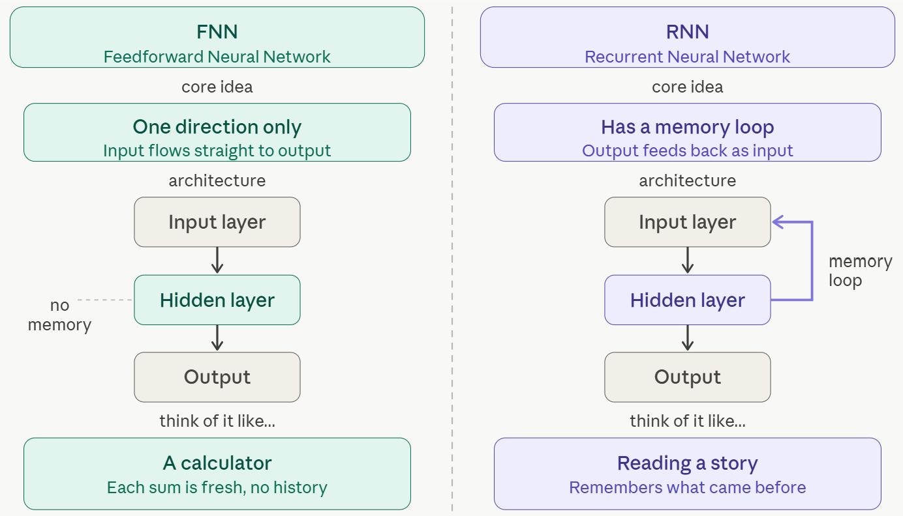
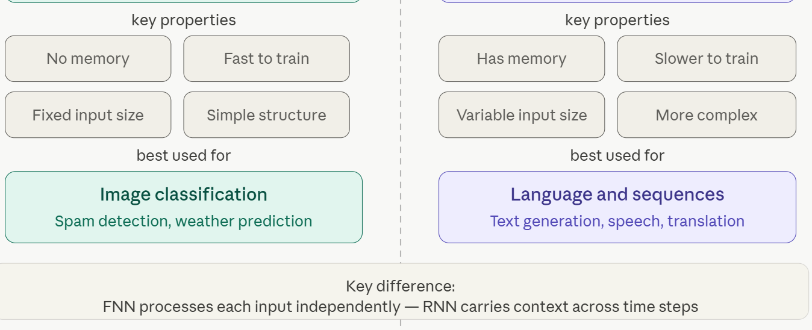
RNN vs. Feedforward Neural Network

Slide 9
Key Terms in RNN
1
Time Step (t)
Each position in the sequence; the model processes one step at a time
2
Hidden State (h_t)
The network's memory; carries information from previous steps forward
3
Weights (W, U)
W connects input to hidden; U connects previous hidden state to current
4
Activation Function
Typically tanh or ReLU; introduces non-linearity into the hidden state
5
Sequence Length
Total number of time steps in the input sequence
6
BPTT
Backpropagation Through Time — the algorithm used to train RNNs across steps

Slide 10
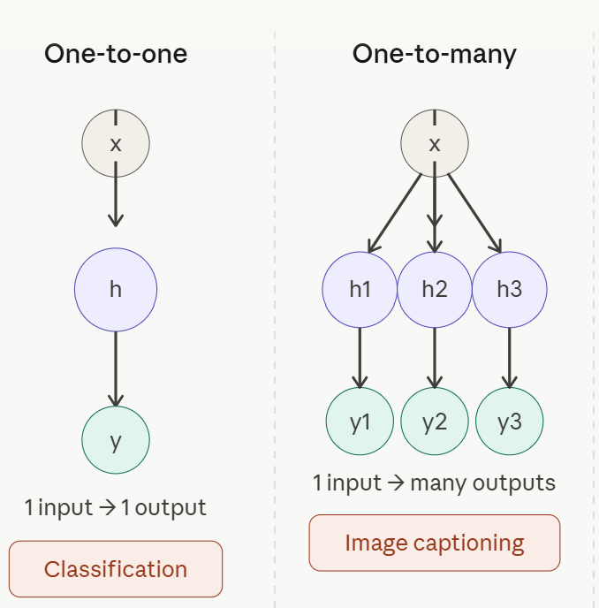
Types of RNN
One-to-One
Single input → single output. Standard mapping, similar to a feedforward network. Used for simple classification tasks.
Many-to-One
Sequence input → single output. Example: sentiment analysis — a full sentence is classified as positive or negative.

Slide 11
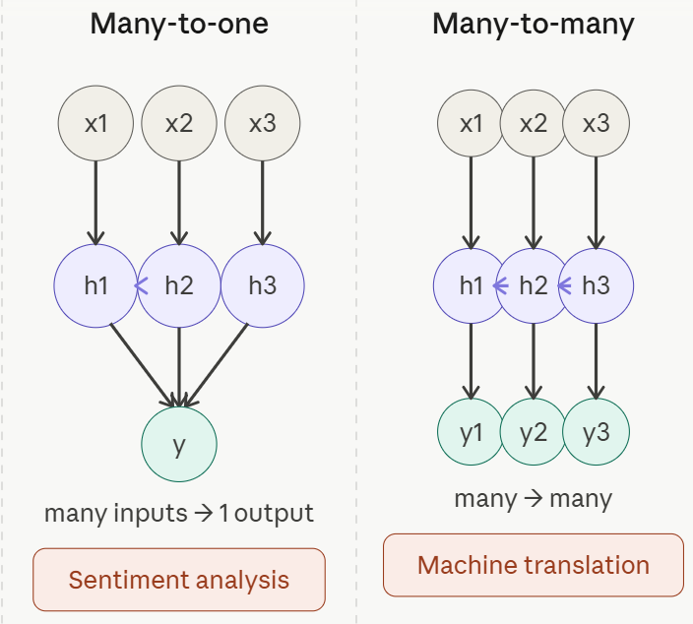
Types of RNN
One-to-Many
Single input → sequence output. Example: image captioning — one image generates a full sentence description.
Many-to-Many
Sequence input → sequence output. Example: machine translation — a sentence in one language maps to another language.

Slide 12

The Vanishing Gradient Problem
During training via BPTT, gradients are multiplied repeatedly across many time steps. When these values are small, they shrink exponentially — approaching zero. As a result, the model effectively forgets long-term dependencies.
What Happens
Solutions
Gradients become very small during backpropagation
Early time steps receive near-zero weight updates
Model loses ability to learn long-range patterns
LSTM
Long Short-Term Memory — uses gating to preserve important information
GRU
Gated Recurrent Unit — a simpler, faster alternative
to LSTM

Slide 13
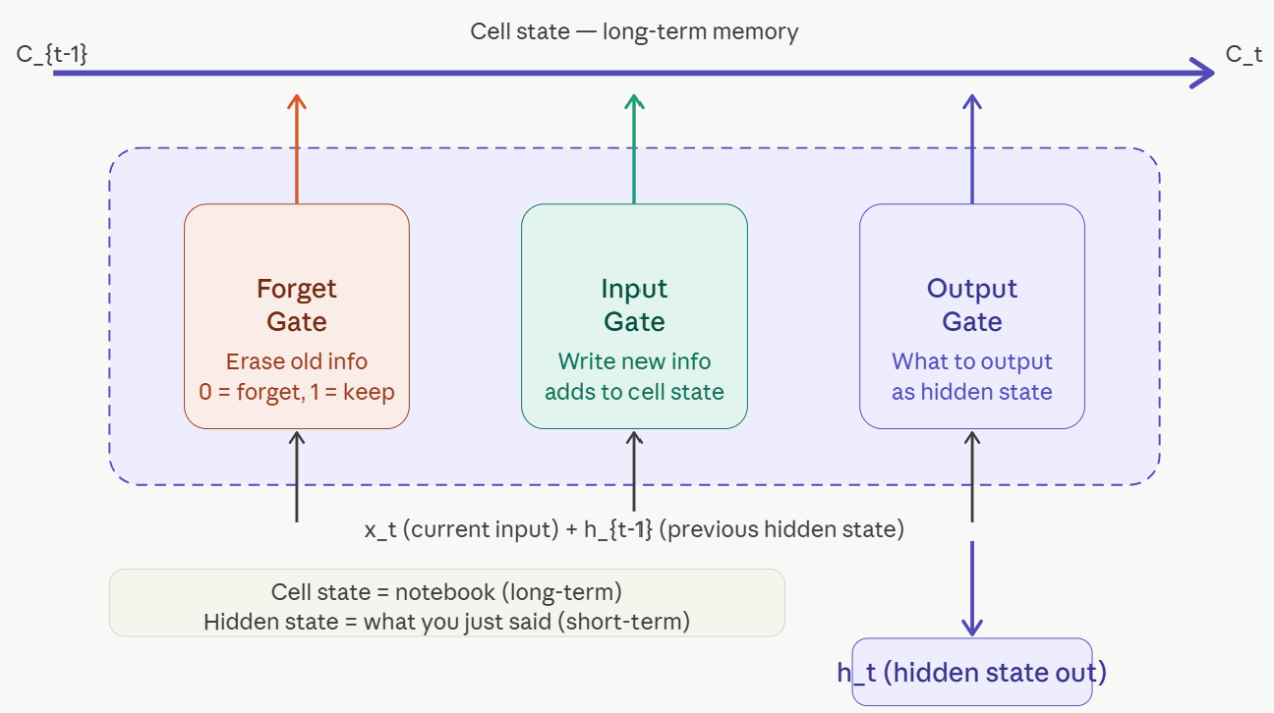
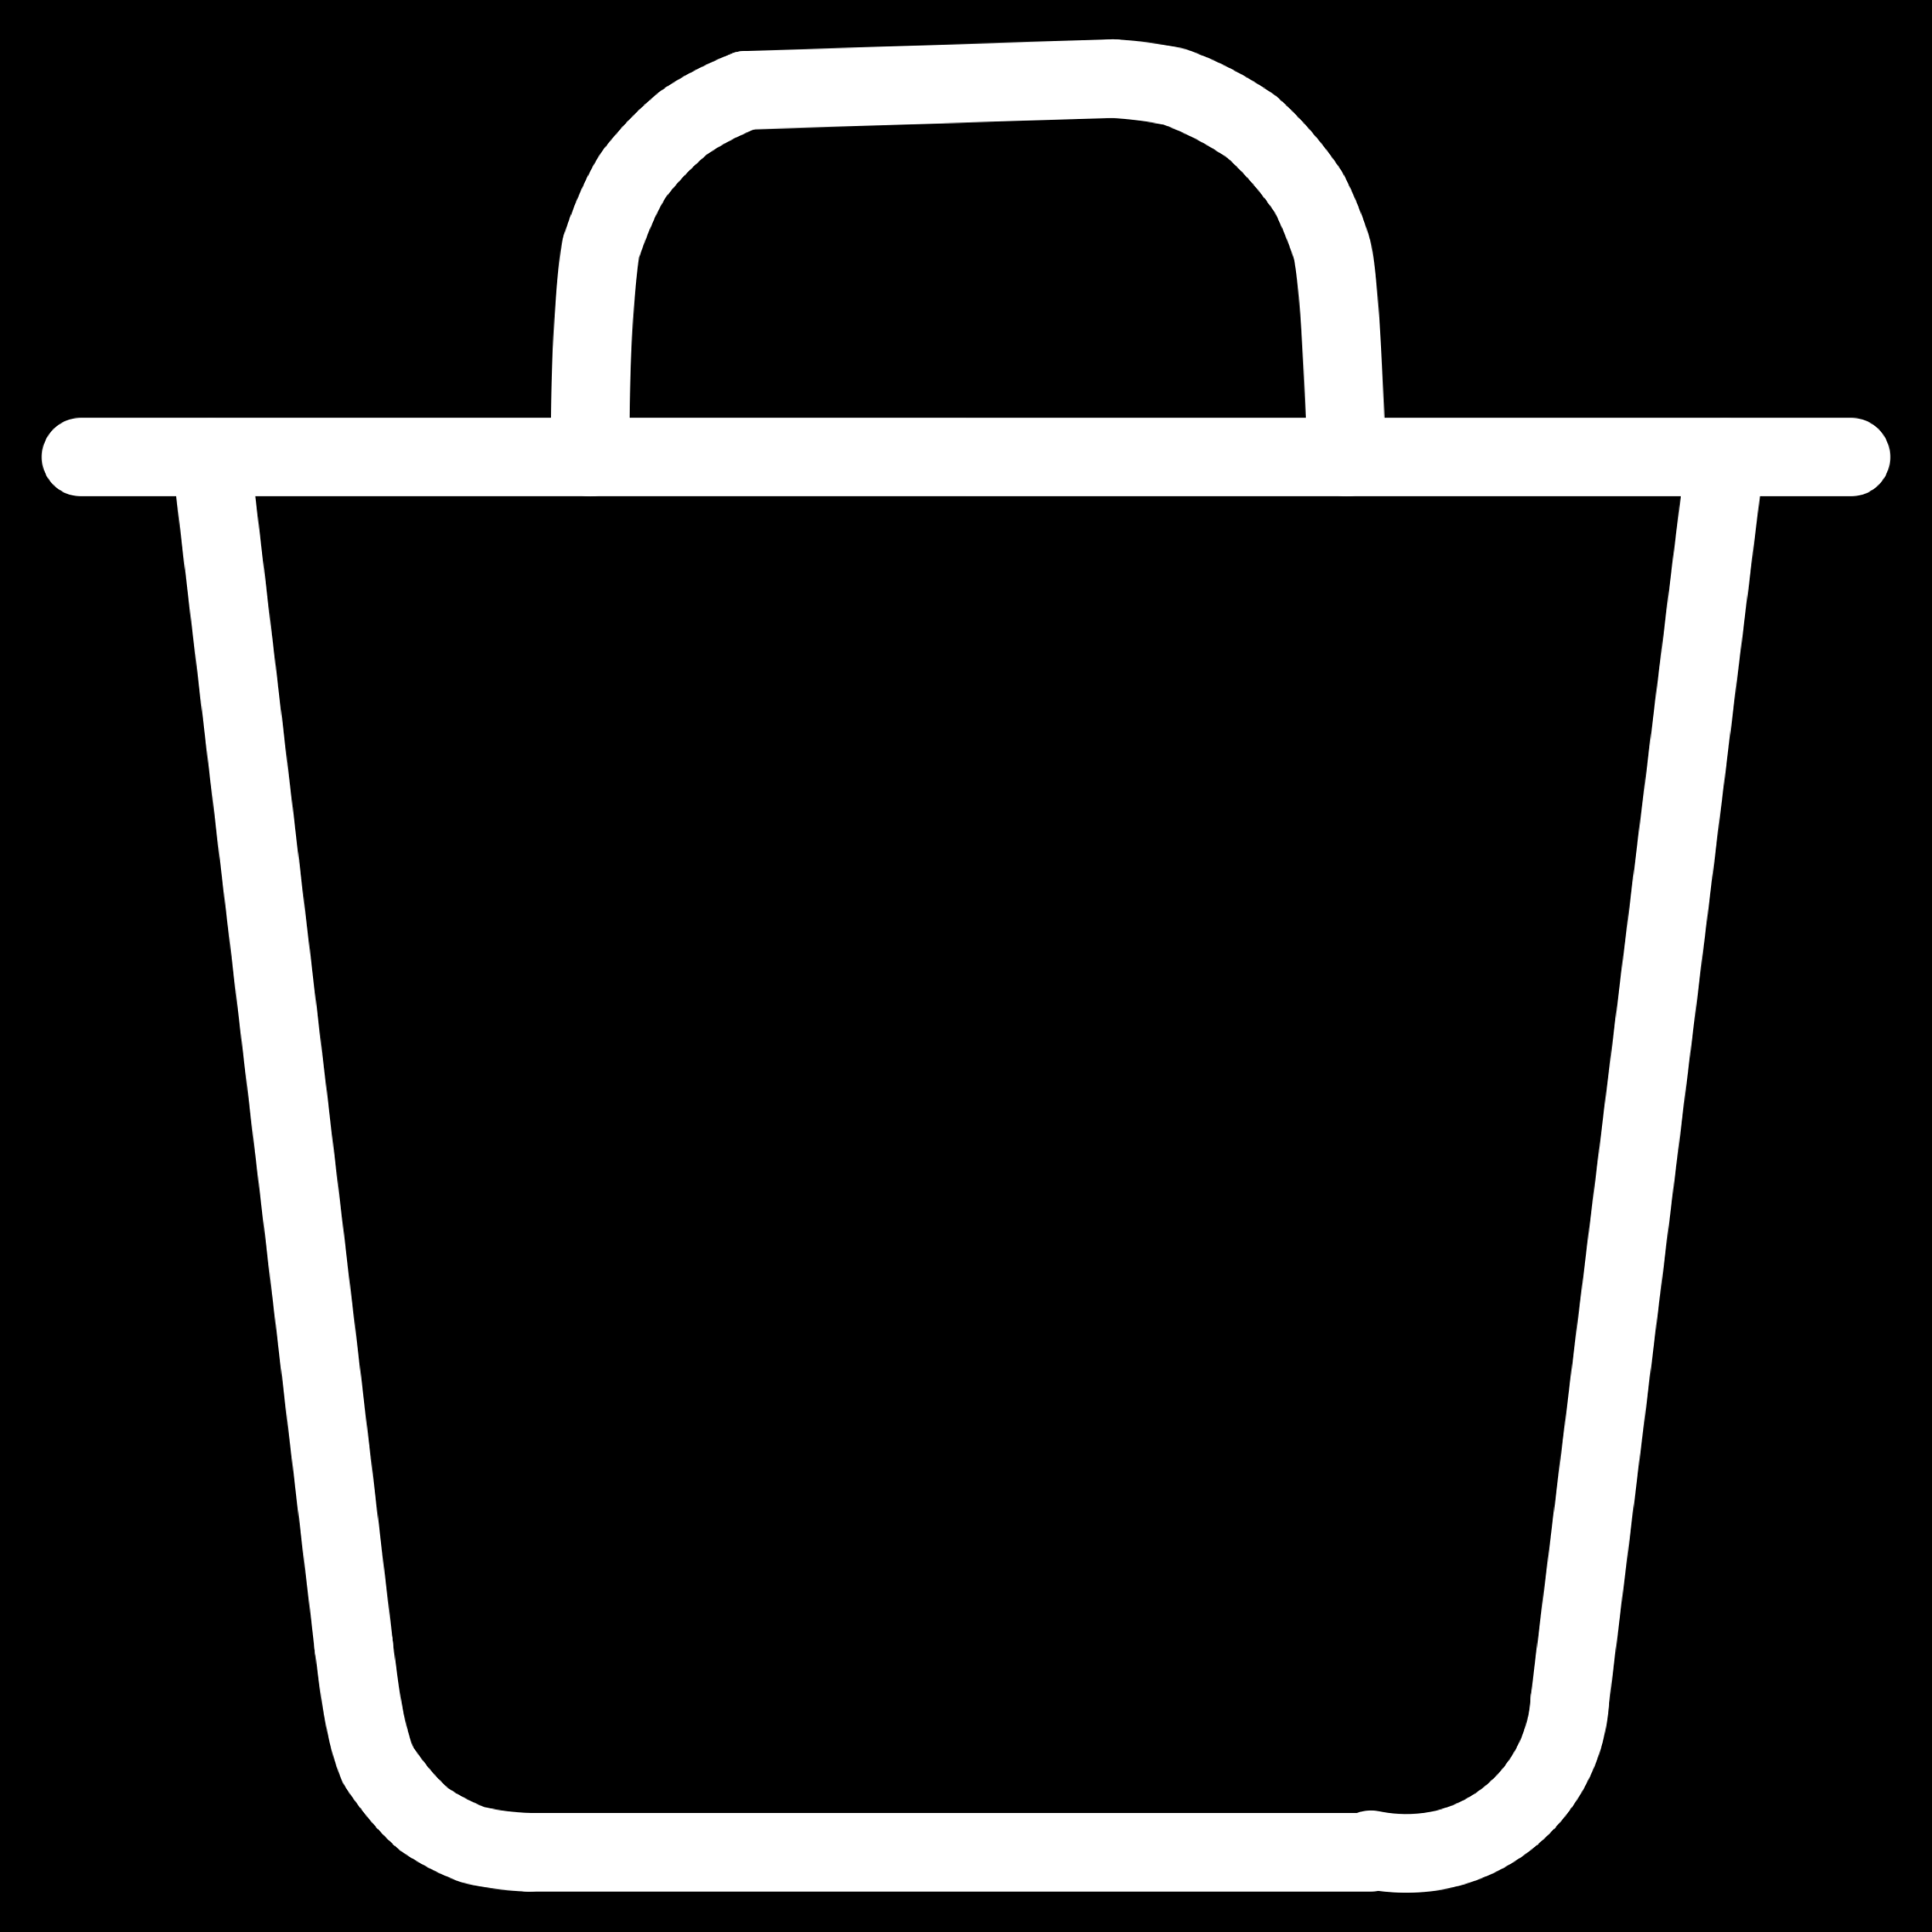
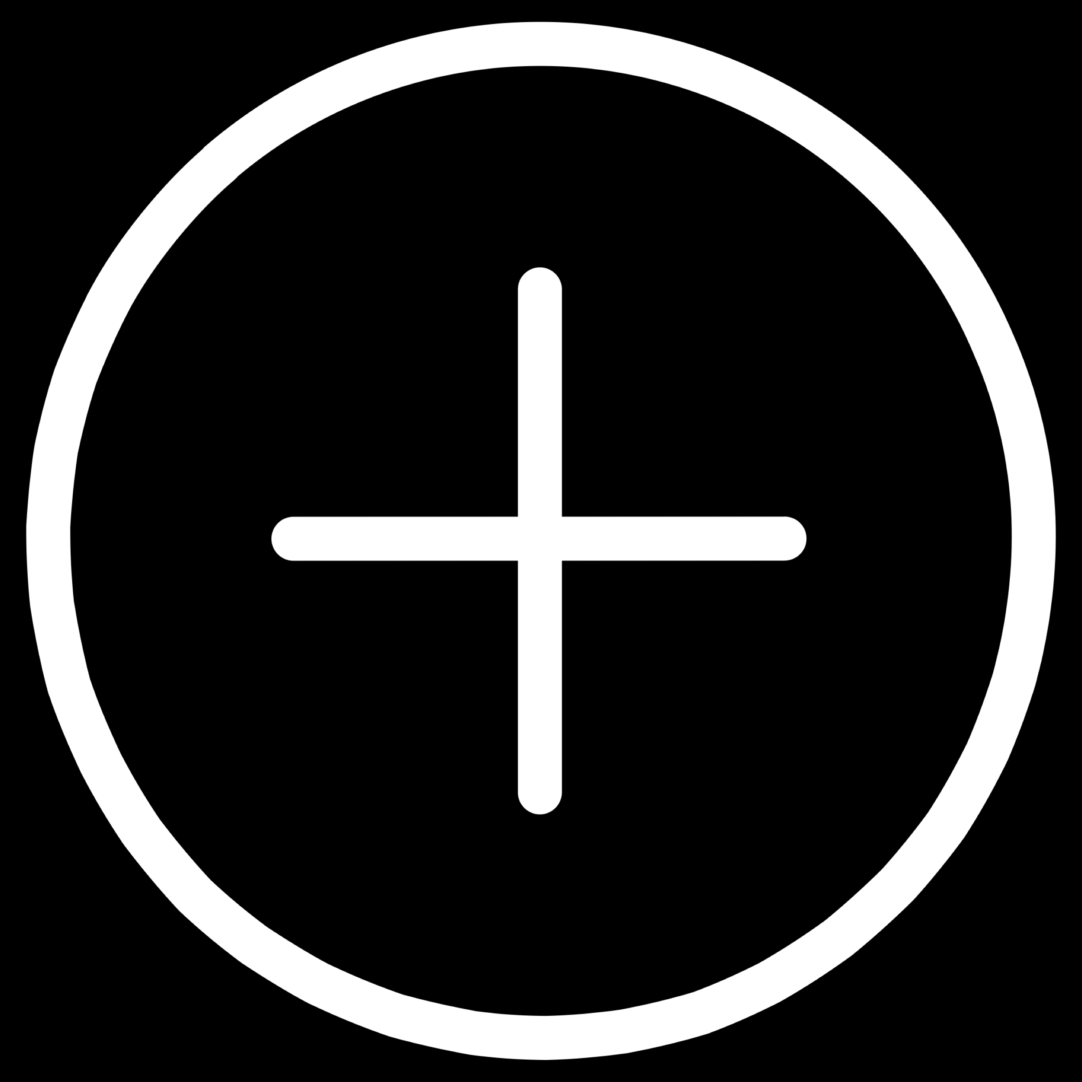
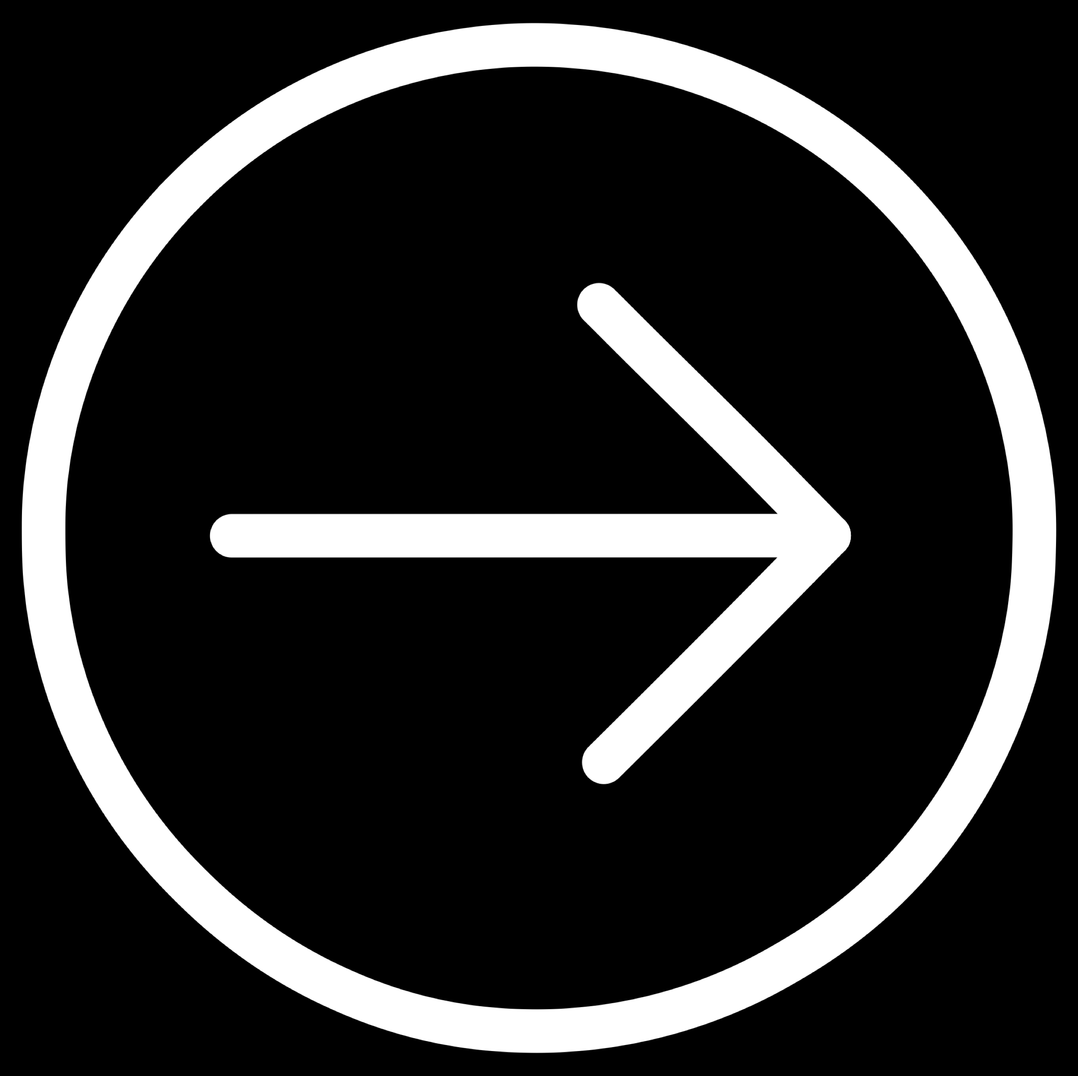
Introduction to LSTM
A Long Short-Term Memory (LSTM) network solves the vanishing gradient problem by introducing gates — mechanisms that control what information is kept, updated, or discarded at each time step.

Slide 14
Introduction to LSTM
Forget Gate
Input Gate
Output Gate
Decides what information from the previous cell state should be discarded. Outputs values between 0 (forget) and 1 (keep).
Decides what new information from the current input should be written into the cell state.
Decides what part of the cell state should be output as the hidden state for the next step.

Slide 15

How LSTM Works
Two Types of Memory
Information Flow
Cell State — Long-Term Memory
Forget
Runs through the entire sequence with minimal modification. Carries important context over many time steps.
Remove irrelevant past information from cell state
Update
Hidden State — Short-Term Memory
Write new relevant information into cell state
Updated at every step. Passed to the next time step and used to generate the output.
Output
Produce hidden state from updated cell state

Slide 16
LSTM Example: Stock Prediction
LSTMs are well-suited for financial time series because stock prices depend on historical patterns. The model learns temporal relationships across multiple input signals to forecast future returns.
Model Inputs
Why LSTM Works Here
Price — historical closing prices
Volume — trading volume over time
RSI — Relative Strength Index (momentum indicator)
Markets have long-range dependencies — events from weeks ago can affect today's price
The forget gate filters out market noise
The cell state preserves meaningful trend signals over time
Outperforms standard RNN on longer sequences due to stable gradients
Model Output
Next day return — predicted percentage change in price

Slide 17



RNN for Text Prediction
RNNs process text as sequences of words or characters, learning the statistical patterns of language to predict what comes next.
Input: "The stock market is" → Output: "volatile"
Autocomplete
Chatbots
Machine Translation
Predicts the next word as a user types, used in search engines and mobile keyboards.
Generates contextually relevant responses by modeling conversational sequences.
Encodes a source sentence and decodes it into a target language using sequence-to-sequence RNN.

Slide 18
Advantages & Limitations of RNN
✅ Advantages
⚠️ Limitations
Handles Sequential Data
Vanishing Gradient
Natively processes time-ordered inputs — text, audio, financial data
Struggles to learn long-range dependencies in deep sequences
Slow Training
Parameter Sharing
Sequential processing prevents parallelization, making training slow on long sequences
Reuses weights across time steps, reducing model complexity
Flexible Architecture
Limited Context Window
Supports one-to-many, many-to-one, and many-to-many configurations
Standard RNNs forget distant past; LSTM/GRU partially address this

Slide 19
Key Takeaways
RNN → Memory
LSTM → Smart Memory
Applications
Processes sequences using a hidden state that carries information across time steps. Defined by:
ht​=f(Wxt​+Uht−1​+b)
Extends RNN with Forget, Input, and Output gates to control long-term and short-term memory independently.
Stock prediction, natural language processing (NLP), speech recognition, autocomplete, and chatbots.
Key Takeaway: When data has order and context, RNNs and LSTMs are the go-to architectures — bridging the gap between static models and real-world sequential problems.

